Slide 1
Continuous Integration
Concepts, Values, and Tools to kick start your own CI process
March 27th, 2010
Erik Stepp

Slide 2
What IS Continuous Integraton?

Slide 3
Continuous Integration is a software development practice where members of a team integrate their work frequently, usually each person integrates at least daily - leading to multiple integrations per day. Each integration is verified by an automated build (including test) to detect integration errors as quickly as possible.
Many teams find that this approach leads to significantly
reduced integration problems and allows a team to develop cohesive software more rapidly.
--Martin Fowler

Slide 4
Benefits of Continuous Integration
Shorten feedback loop
Broken build
Failed tests
Can’t deploy
Reduce risks
Exercise whole build and deployment process
Provide confidence of quality
Unit, integration, functional testing
Code metrics
Code conformance
Notes:
Avoid “Build on my machine” syndrome
Metrics = coverage, complexity, coherence, coupling
Conformance = Styles, FxCop

Slide 5
HOW DOES IT WORK?

Slide 6
CI Servers
Atlassian’s Bamboo
ThoughtWorks’ Cruise
CruiseControl family (CC, CC.NET, CC.rb)
Hudson
JetBrains’ TeamCity
Microsoft’s Team Foundation Server
Notes:
Cruise Control .NET (open source)
Hudson (open source)
Team City (JetBrains)
Cruise (ThoughtWorks)
Bamboo (Atlassian)
Team Foundation Build

Slide 7
Components
CI Server
Background process
Web site
Notification (email, system tray, RSS, etc.)
Build Scripts
Compile
Deploy
Run tests

Slide 8
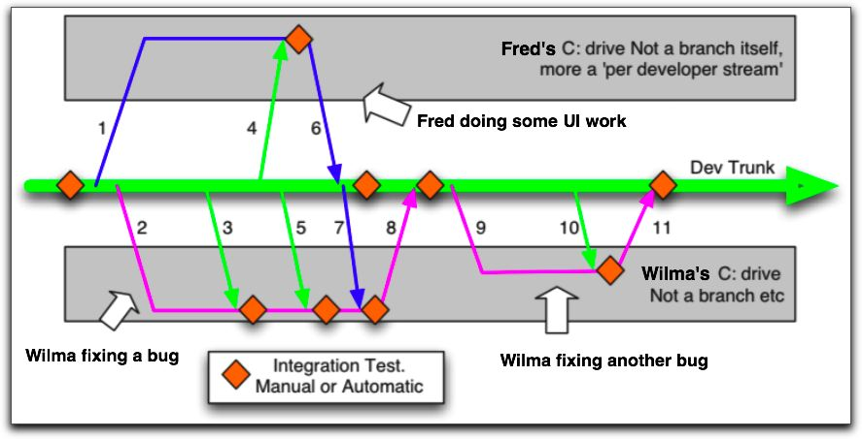
Continuous Integration

Slide 9
GETTING STARTED

Slide 10
Get it building locally
Write an automated build script.
MSBuild is a good place to start
Consider other build tools when you grow
MSBuild Extension Pack
NAnt + NAntContrib
PSake
Make it simple and fast

Slide 11
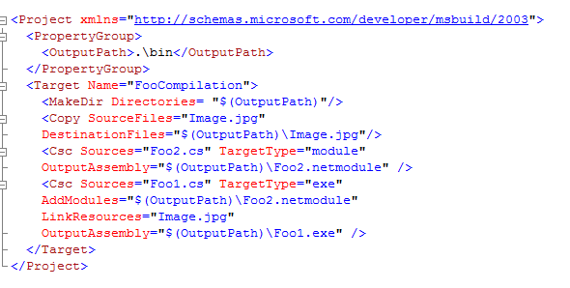
Build Scripts – MSBuild

Slide 12
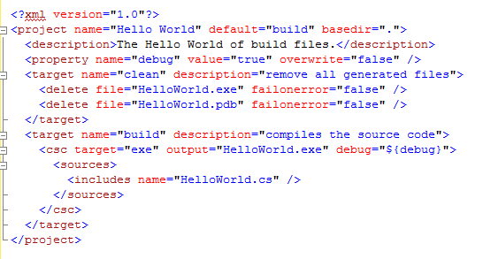
Build Scripts – NAnt

Slide 13
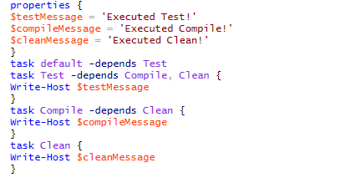
Build Scripts – psake

Slide 14
Manage Dependencies
Consider adding 3rd party tools to SCC
Add 3rd party libraries to SCC
Commit binaries so that you don’t need to build these every time.
Prefer a public release. Avoid custom changes.
Document clearly which version you use.

Slide 15
Quality in Depth
Compilation
Unit Testing
Functional/UI Testing
Deployment
Code Metrics

Slide 16
Oops, I did it again
Build status must be visible
Use the systray app for your CI server
Consider adding the Build Dashboard to an “Information Radiator”
Some have used ambient lights, lava lamps, or even songs to let the whole team know when a build breaks.

Slide 17
Notifications
Emails
System Tray utilities (CCTray, CCMenu, etc.)
RSS feed
Text Message

Slide 18
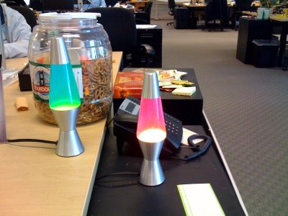
Notifications – Lava Lamps
http://agileworks.blogspot.com/2009/02/lava-lamp-with-cruisecontrol.html

Slide 19
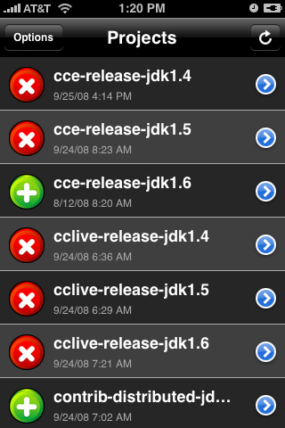
Notifications – iPhone app

Slide 20
Introducing CI
Compile-Only builds can work as “training wheels” for a team that is new to CI.
Add metrics early so that you can measure your progress as you add automated testing.
Add automated tests ASAP.
Make a clear distinction between automated Unit Tests and Functional Tests.
Automate deployment.

Slide 21
Educate Developers

Slide 22
Check-In Process
Wait for the CI server to be green.
Sync your local working folder.
Verify the code works using the same build script as the build server.
If the CI server is still green, commit your changes.
Verify that the CI server is green before you leave.

Slide 23
Best Practices
Only do atomic commits. Check-in all or nothing.
Don’t wait until you want to leave for the day. Give yourself time to resolve failures.
Check-in often.
Learn the build process. Don’t treat it as a “black box”.
Ignore generated binaries in source control.

Slide 24
Broken Builds
If someone breaks the build, own it and let everyone else know that you’re fixing it.
Don’t take a broken build too lightly.
Don’t take a broken build too seriously, either.
Resolve the broken build quickly. If it will take a while to figure it out, revert the commit that broke it.

Slide 25
Automated TESTING

Slide 26
I see CI as primarily giving birth to a release candidate at each commit. The job of the CI system and deployment process is to disprove the production-readiness of a release candidate.
This model relies on the need to have some mainline that represents the current shared, most up to date picture of complete.
--Dave Farley

Slide 27
Quality in Depth
Compilation
Unit Testing
Functional/UI Testing
Deployment
Code Metrics

Slide 28
Automated Testing Tools
NUnit
MbUnit
xUnit
MSTest
PartCover
NCover

Slide 29
Of course you can't count on tests to find everything. As it's often been said: tests don't prove the absence of bugs. However perfection isn't the only point at which you get payback for a self-testing build. Imperfect tests, run frequently, are much better than perfect tests that are never written at all.
- Martin Fowler

Slide 30
Contact Information

Slide 31
Erik Wynne Stepp
erik.stepp@gmail.com
@erikwynne
http://azurestuff.com
http://meetup.com/silverlight

